Slide 1
Agile Workspace

Slide 2
What is Agile Model?
Agile Model is an iterative model of software development.
Agile SDLC model is a combination of iterative and incremental process models with focus on process adaptability and customer satisfaction by rapid delivery of working software product.
Each iteration typically lasts from about one to three weeks.
At the end of the iteration, a working product is displayed to the customer and important stakeholders.

Slide 3
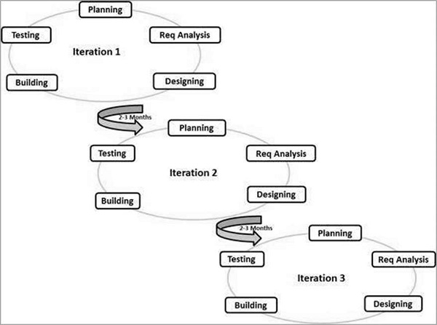
Agile Model Workflow Example.

Slide 4
Why use Agile??
Agile is based on the adaptive software development methods, whereas the traditional SDLC models like the waterfall model is based on a predictive approach.
Predictive methods entirely depend on the requirement analysis and planning done in the beginning of cycle. Any changes to be incorporated go through a strict change control management and prioritization.
Agile uses an adaptive approach where there is no detailed planning and there is clarity on future tasks only in respect of what features need to be developed.
Customer Interaction is the backbone of this Agile methodology, and open communication with minimum documentation are the typical features of Agile development environment.

Slide 5
Advantages:
Customer satisfaction.
Interaction between teams and customer.
Fast delivery.
Easy recognition to the work done in short periods of time.
Bond between the team members is stronger.
Change will be occurring frequently.

Slide 6
Disadvantages:
Not useful for small projects.
Need expert member to take the decisions.
High cost.

Slide 7
Characteristics:
1. Incremental, iterative, and ready to evolve.
2. Face to face communication.
3. Feed back loop.

Slide 8
Principles:
1. Customer satisfaction.
2. Welcome change.
3. Deliver the working software frequently.
4. Collaboration.
5. Motivation.
6. Face to face conversation.

Slide 9
7. Measure the progress as per working software.
8. maintain constant pace.
9. Monitoring.
10.Simplicity
11.Self-organised teams.
12.Review the work regularly.

Slide 10
Thank You

